Slide 1

Exploratory Data Analysis of Product Failures
Phase2: Predictive Product Failures

Slide 2
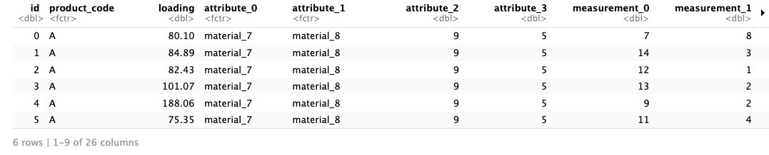
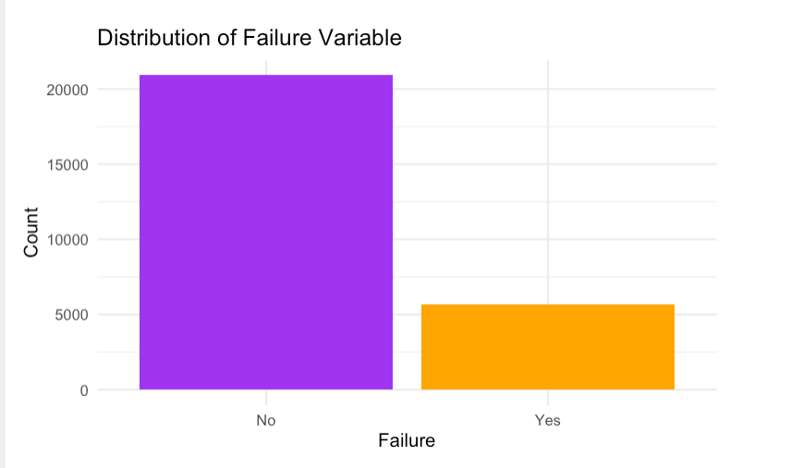
Training Dataset Overview
The dataset we are working with contains 26 variables that can help predict product failures. The most important variables include:
Product Code: This categorical variable indicates different product types, which might have varying failure rates.
Loading: A numerical variable representing the stress or load placed on the product, which we hypothesize has a strong link to failure.
Measurements: There are multiple measurements related to the product's characteristics, and these help us understand potential correlations with failure.
Failure: This is the target variable, categorized as 'Yes' for failed products and 'No' for non-failed ones.
As shown in the bar chart, the dataset is slightly imbalanced, with around 21% of the products failing. This imbalance suggests that our model will need to be particularly careful in predicting the minority 'failure' class accurately.

Slide 3
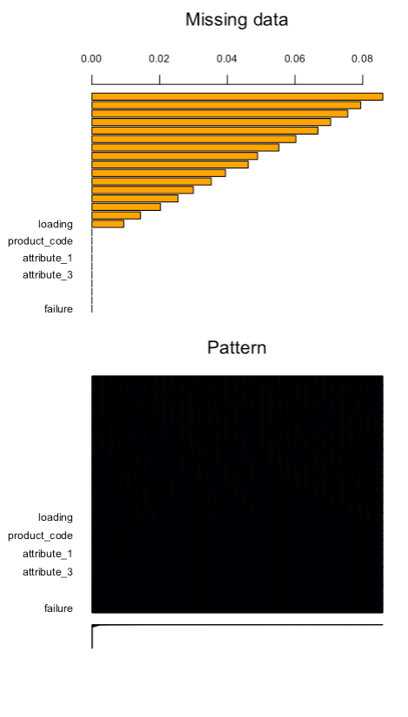
Handling Missing Data
While much of the dataset is complete, we identified missing values in key variables:
Loading had about 250 missing values, but the amount was relatively small (~1%)
Missing loading values were removed (row-wise deletion) as loading is an important variable
For other variables with missing data, imputation was performed to fill in the gaps while preserving data quality
This approach ensured that we retained as much useful data as possible for analysis..

Slide 4
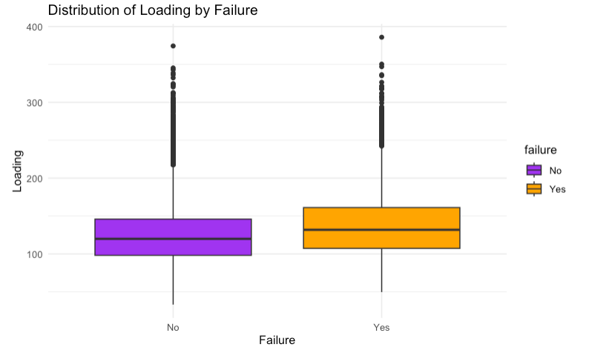
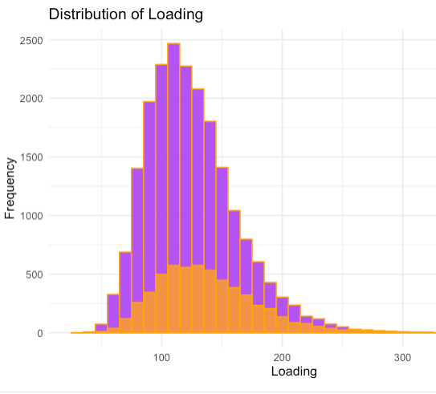
Data Cleaning & Factor Conversion
Distribution of Loading by Failure (Boxplot):
The boxplot clearly shows that products labeled as "Yes" (failed) tend to have higher loading values, with a noticeable difference in the median loading between "Yes" and "No" categories. The higher loading associated with failures indicates that loading is a strong predictor for failure.
There are several outliers in both categories, but the trend suggests that failure rates increase as loading values rise, which supports the decision to retain higher loading values during data cleaning instead of removing them as outliers.
Distribution of Loading (Histogram):
The histogram demonstrates a right-skewed distribution of the loading variable, with most products having lower loading values, but a few outliers at the higher end.
The overlap between failed and non-failed products is clear, though products with higher loading values are more likely to fail. This visual emphasizes the potential threshold effect, where a higher loading correlates with a higher failure probability.

Slide 5
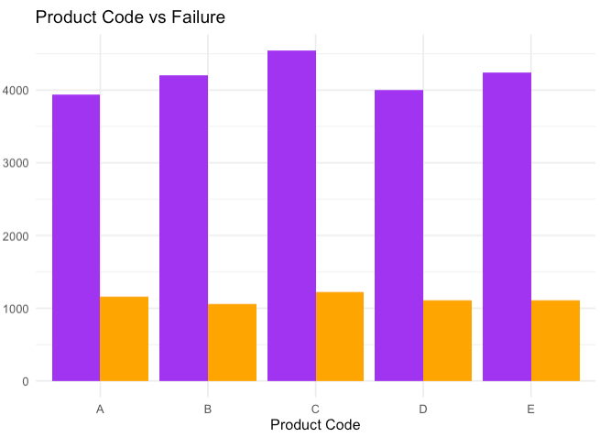
Building Predictive Models
Product codes A, B, and C have a higher number of non-failed products compared to D and E.
The number of failed products is fairly consistent across all product codes, with around 1,000 failures each.
Product Code C has the highest count of non-failed products, while D and E show relatively fewer non-failures, suggesting a possible higher failure rate for these product types.
This visual is helpful for understanding how failure rates vary by product code and could guide further investigation into specific factors influencing product failures across different product types.

Slide 6
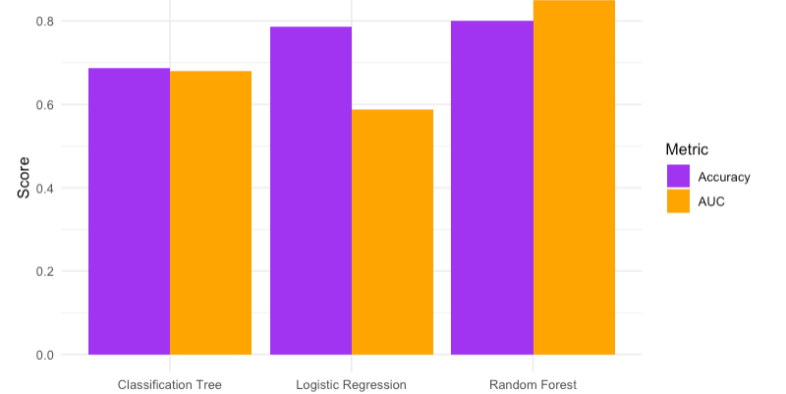
Model Performance Comparison
Random Forest Outperforms Other Models:
Random Forest has the highest Accuracy (approximately 80%) and the highest AUC (around 0.85).
This indicates that Random Forest is the most reliable model among the three for predicting product failures. It performs well both in terms of overall prediction correctness (accuracy) and its ability to distinguish between failing and non-failing products (AUC).
Logistic Regression:
Logistic Regression has a relatively high Accuracy (approximately 79%), which is close to Random Forest's accuracy.
However, the AUC for Logistic Regression is notably lower (around 0.59), suggesting that while the model can predict failure/non-failure cases correctly in many instances, it struggles to effectively distinguish between the two classes when it comes to probabilistic discrimination.
This gap between accuracy and AUC indicates that Logistic Regression may be over-relying on one class (probably the majority class, non-failures), which could be masking its performance in distinguishing the two classes.
Classification Tree:
Classification Tree has the lowest performance overall, with an Accuracy of around 69% and an AUC of around 0.68.
Although the model is interpretable, its performance is significantly weaker compared to Random Forest and Logistic Regression. This suggests that while it might be useful for understanding the decision-making process, it may not be the best choice for accurate prediction of product failures in this dataset.

Slide 7
Conclusion and Recommendation
Based on this comparison, Random Forest is the most promising model for this dataset. Its high accuracy and AUC make it the best fit for predicting product failures.
Further tuning of the Random Forest model (e.g., adjusting the number of trees, depth of trees, etc.) could improve its performance even further.
While Logistic Regression offers decent accuracy, the low AUC suggests a need for improvement. You might explore feature engineering or regularization techniques to boost its AUC.

